Slide 1
Mumin Start

Slide 2
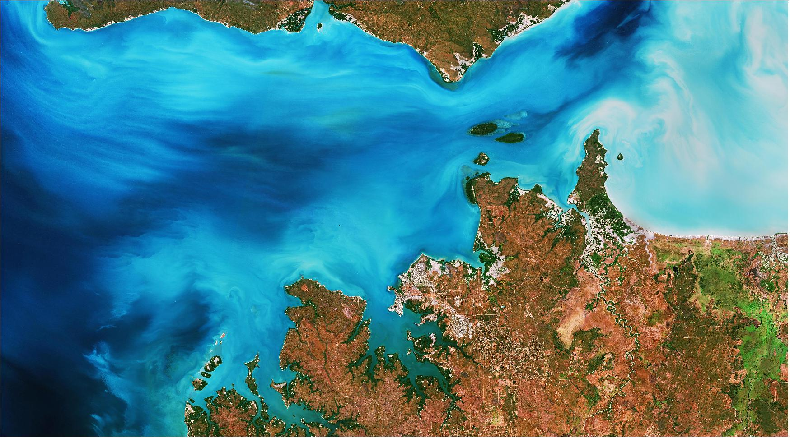
Irrigation Detection Ablation Study
Atit, Jacob, Mahdieh, Mumin

Slide 3
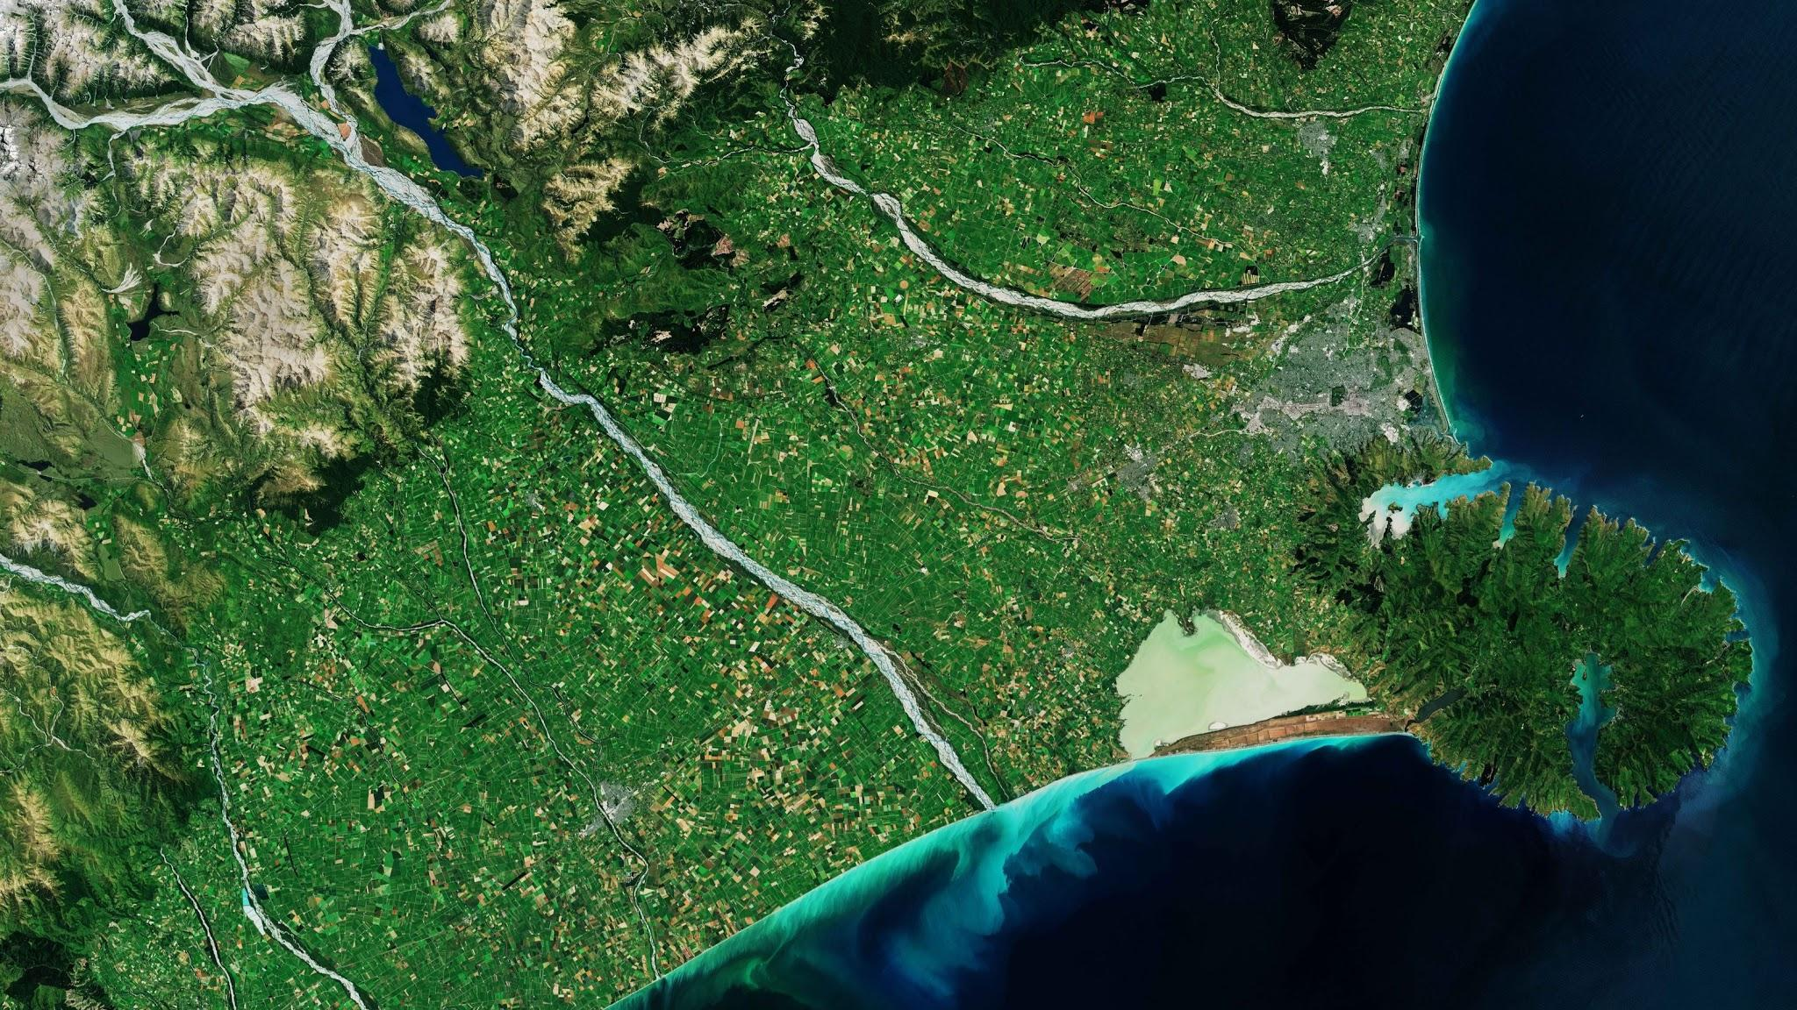
Agenda
Problem Statement
Intro to Ablation Studies
Project Goals
Dataset Overview
Experiments
Conclusion and Follow-Up Research

Slide 4
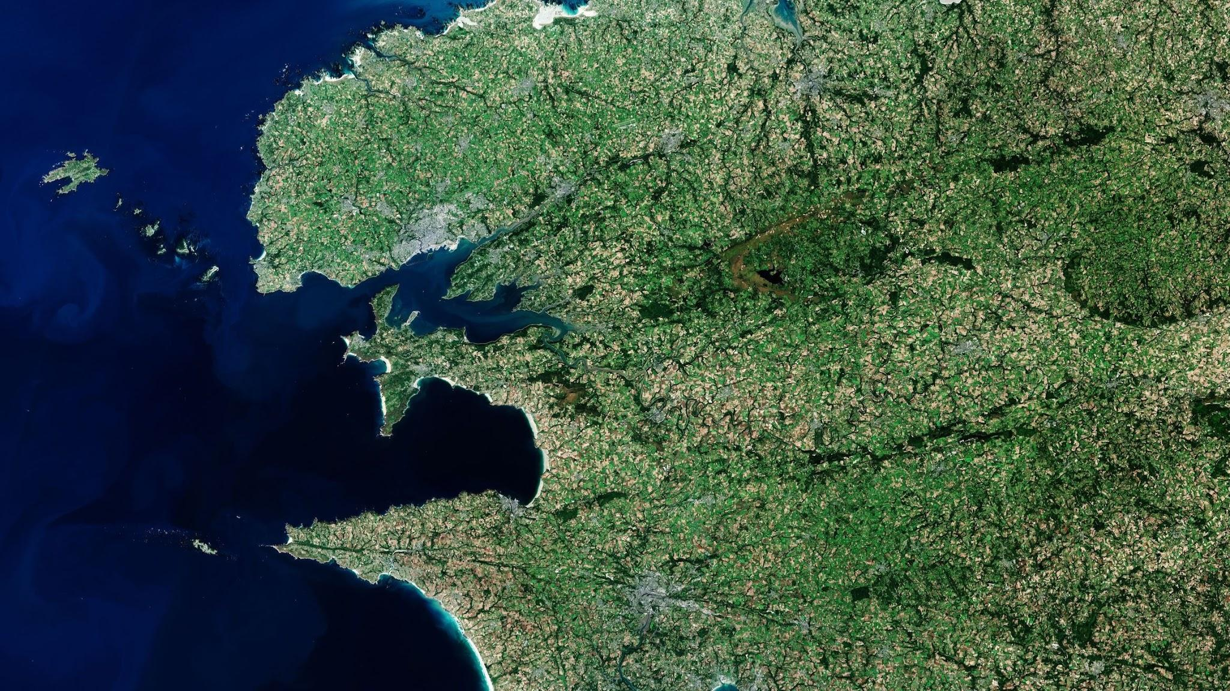
Problem Statement
Problem
Problem
Our Solution
Remote sensing usage:
monitoring crop conditions
mapping cultivation activity
assessing land use
predicting harvests
But it is a very tedious and time consuming if we want to do it at manually and at scale
Irrigation detection can enable different areas:
food security
climate and weather modeling
water rights laws
water budgets
Public policies
But It is very resource intensive to train machine learning model for satellite images
Deep learning model to do remote sensing using satellite images to detect irrigation
We did an ‘Ablation Study’ to understand the effect of each band on performance metrics
Notes:
Monitoring of soil properties and crop conditions, along with cultivation activity mapping, helps researchers and farmers to assess land use, predict harvests, monitor seasonal changes and assist in implementing policies for sustainable development.

Slide 5
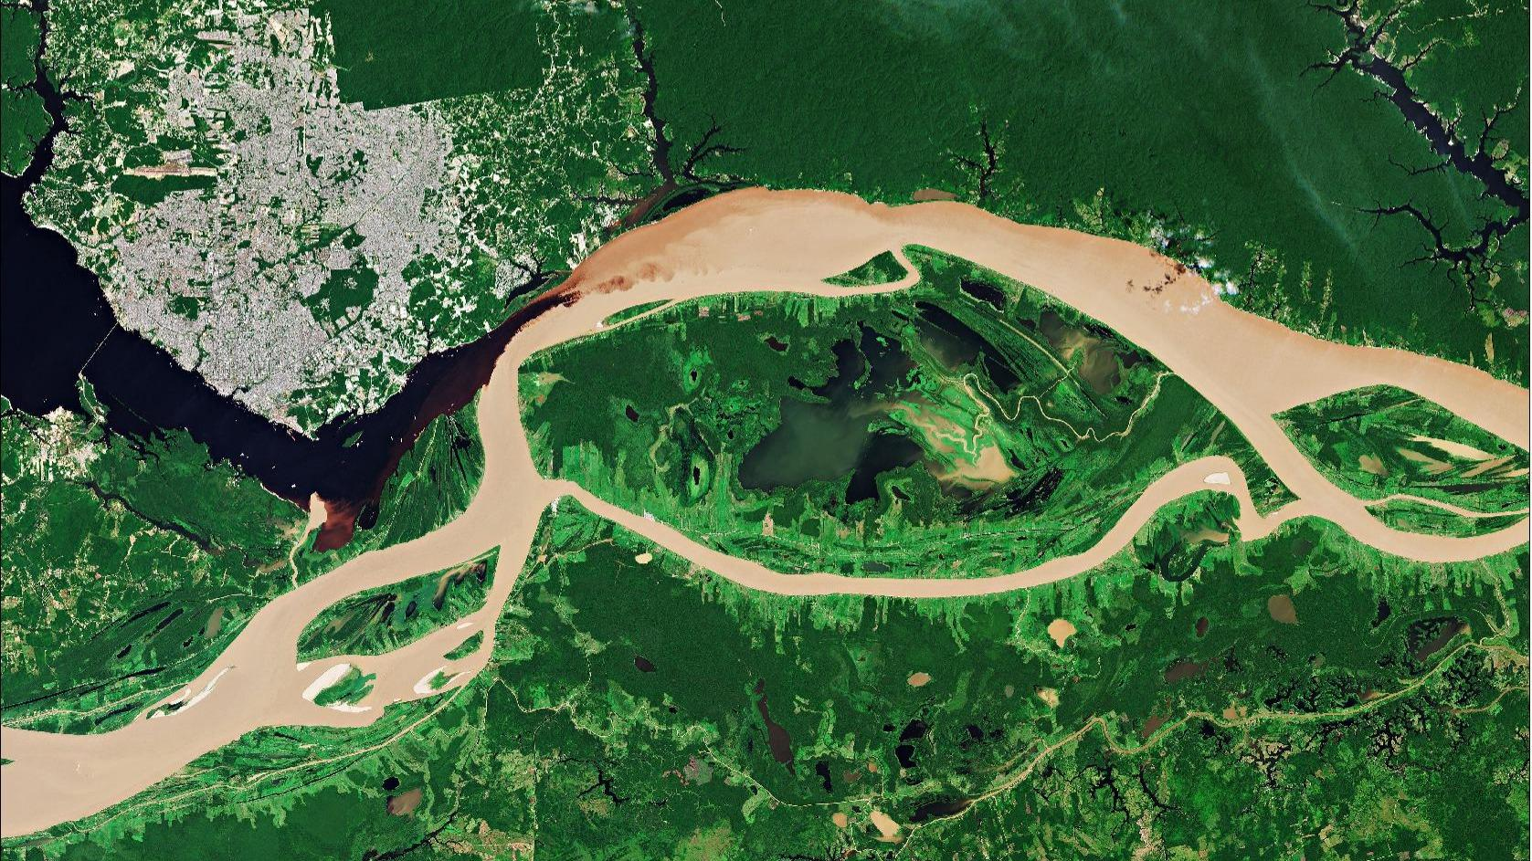
What is an Ablation Study???
What:
In medical and psychological research:
Removal of a single organ, tissue, or any part of a living organism
Examine the behaviour of the organism in its absence
In machine learning:
a scientific examination of a machine learning system in order to gain insight on the effects of its building blocks on overall performance
Notes:
In medical and psychological research: is a research method in which the roles and functions of an organ, tissue, or any part of a living organism, is examined through its surgical removal and observing the behaviour of the organism in its absence

Slide 6
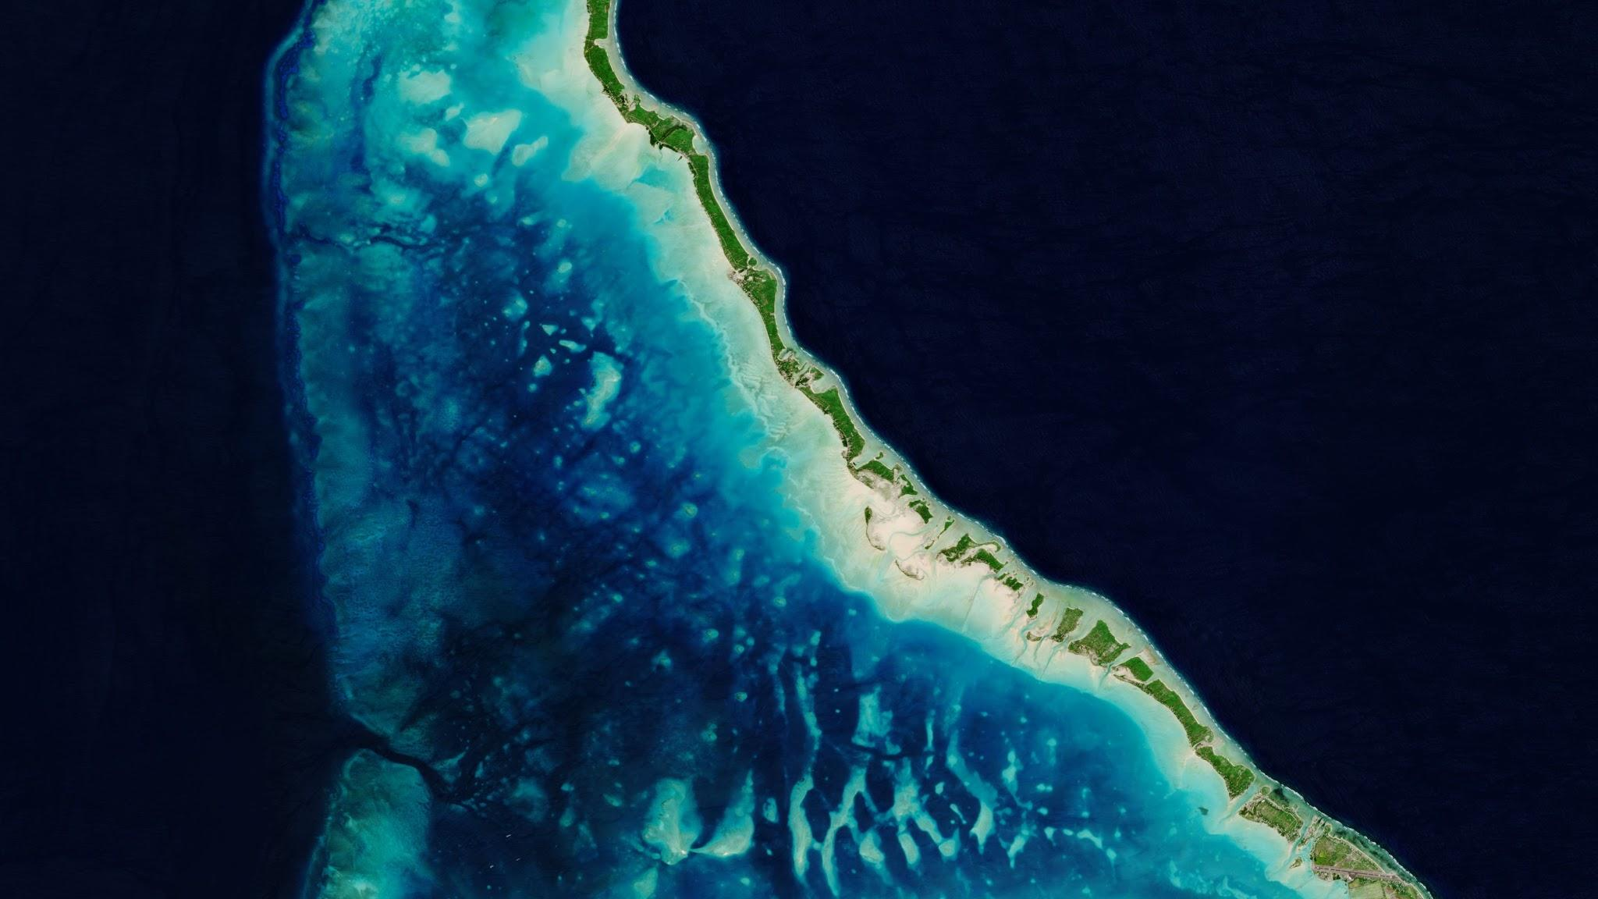










Ablation via Hamburgers!
Exp 1
Exp 4
Exp 2
Baseline
Exp 7
Exp 6
Exp 5
Exp 3
Exp 9
Exp 8

Slide 7
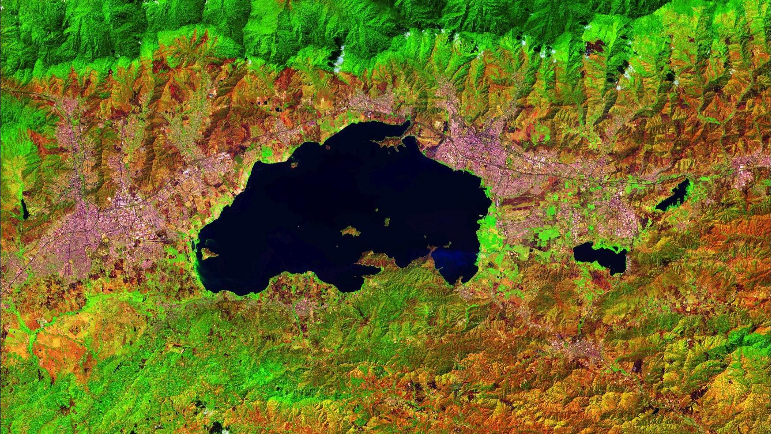
Project Goal
To better understand causality in machine learning satellite irrigation detection systems
To remove as much training information as possible with little or no loss of performance

Slide 8
Jacob Start

Slide 9
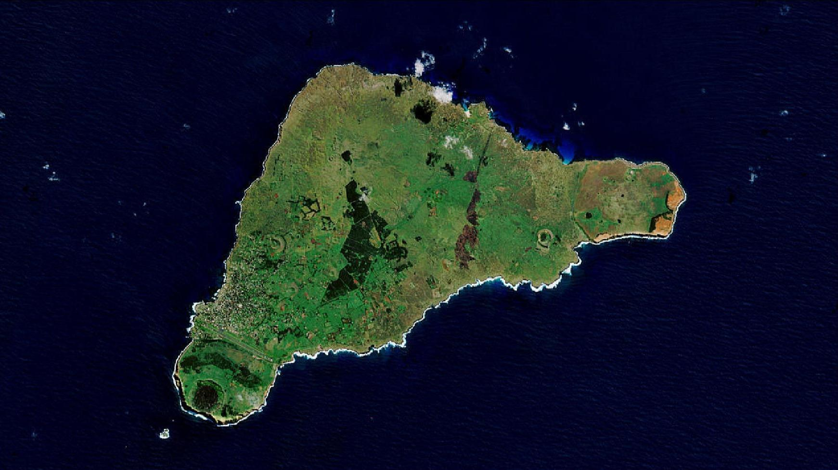
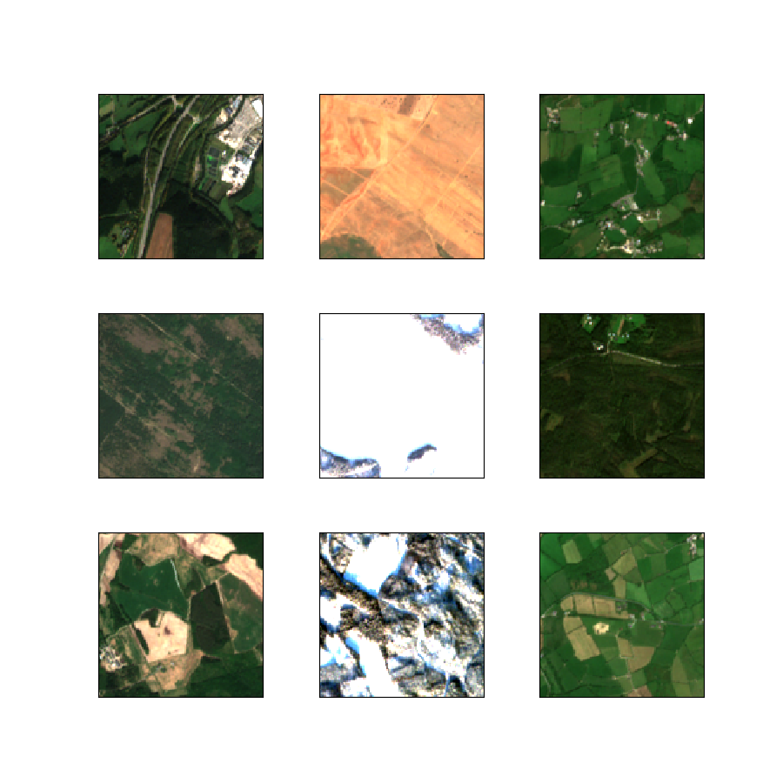
Dataset
BigEarthNet
590,326 Sentinel-2 image patches
Acquired between June 2017 and May 2018 over 10 European countries
Austria, Belgium, Finland, Ireland, Kosovo, Lithuania, Luxembourg, Portugal, Serbia, Switzerland
Each sentinel-2 image has 12 bands as a separate .tif (geotiff) file

Slide 10
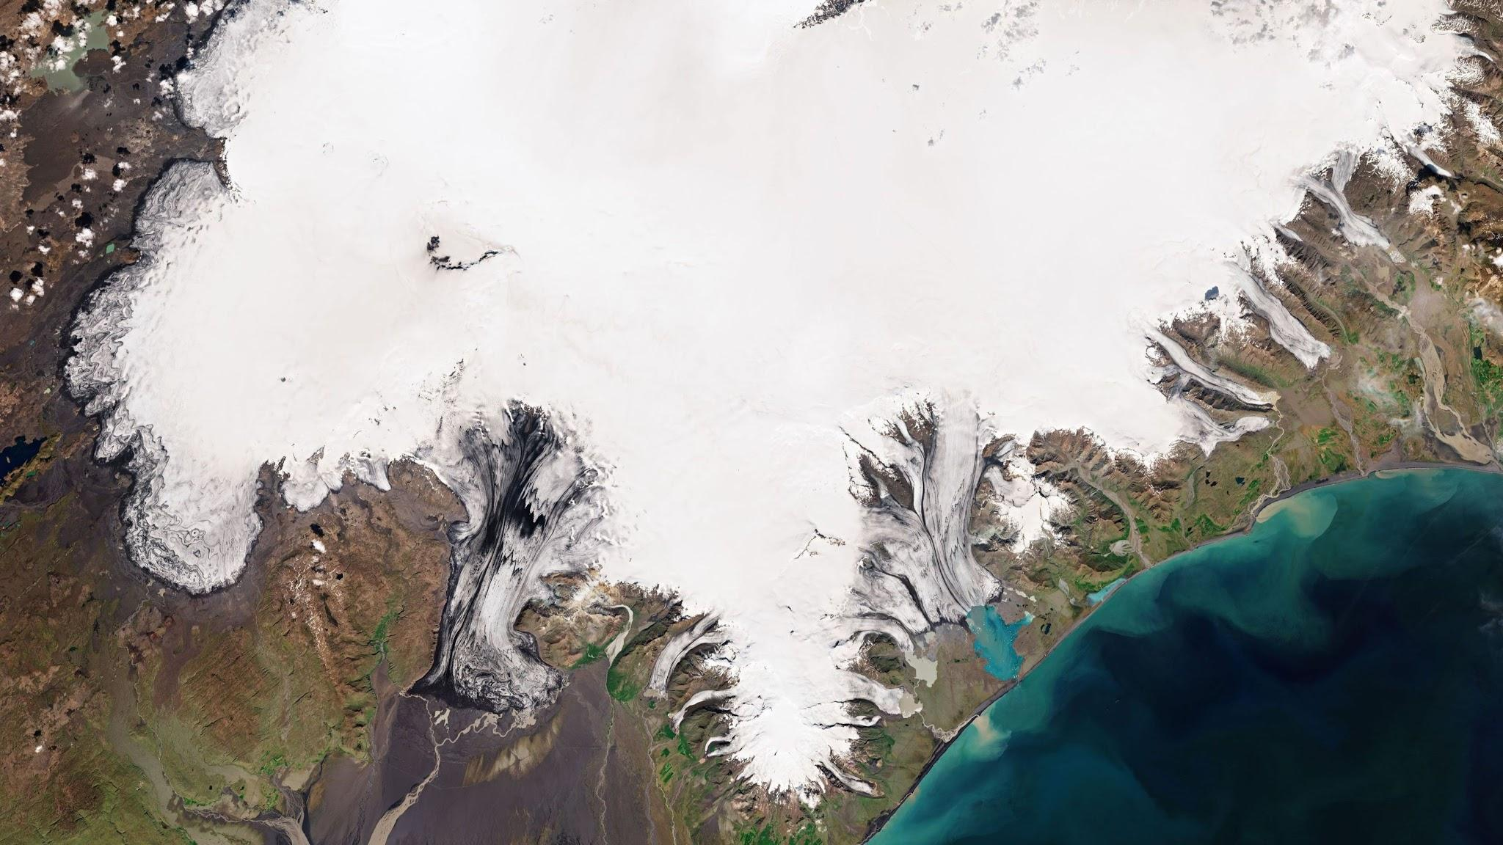
Band | Resolution | Wavelength | Description
B01 | 60m | 443 nm | Coastal aerosol
B02 | 10m | 490 nm | Blue
B03 | 10m | 560 nm | Green
B04 | 10m | 665 nm | Red
B05 | 20m | 705 nm | Vegetation red edge
B06 | 20m | 740 nm | Vegetation red edge
B07 | 20m | 783 nm | Vegetation red edge
B09 | 60m | 940 nm | Water vapor
B08 | 10m | 842 nm | Visible and near infrared (VNIR)
B8A | 20m | 865 nm | Visible and near infrared (VNIR)
B11 | 20m | 1610 nm | Short wave infrared (SWIR)
B12 | 20m | 2190 nm | Short wave infrared (SWIR)

Slide 11
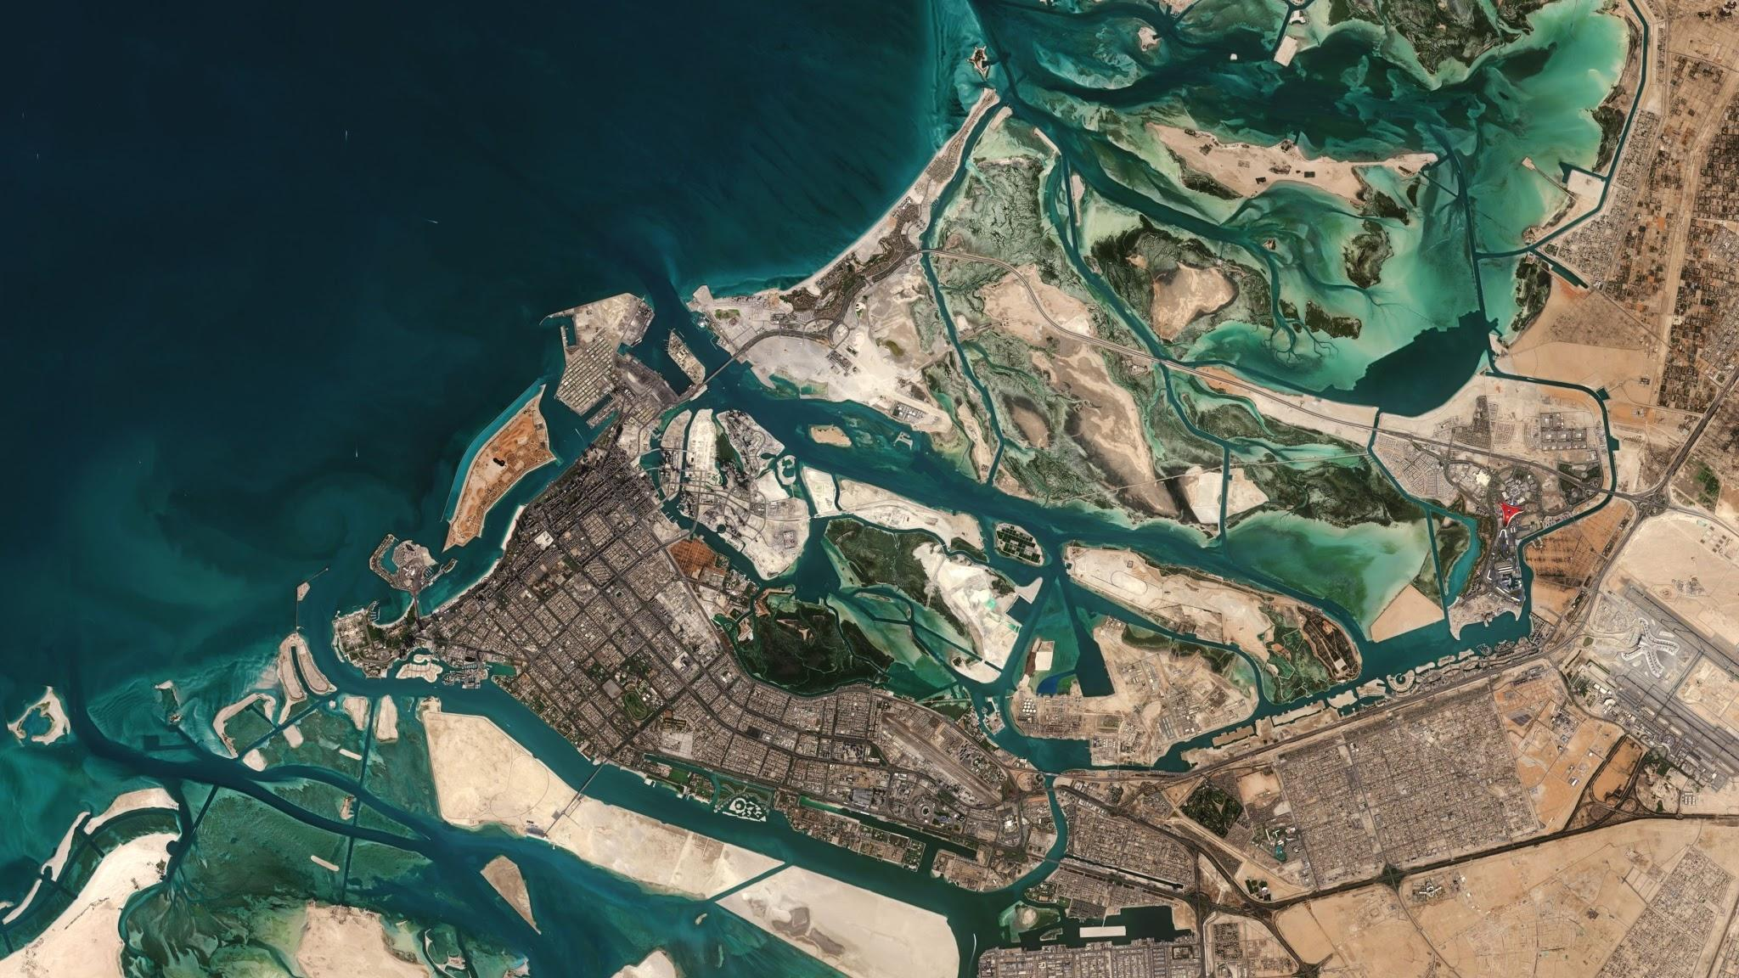
Purpose of each band
Coastal Aerosol - Measures the concentration of aerosols in the atmosphere
Blue - Blue light
Green - Green light
Red - Red light
Vegetation Red Edge - Measures infrared reflectance of Chlorophyll
Near Infrared Reflectance - Used to get quality properties of agricultural products
Water Vapor - Measures the amount of moisture in the atmosphere
Shortwave Infrared - Measure water levels in plants and soil
Narrow Near Infrared Reflectance - Captures vegetation health status

Slide 12
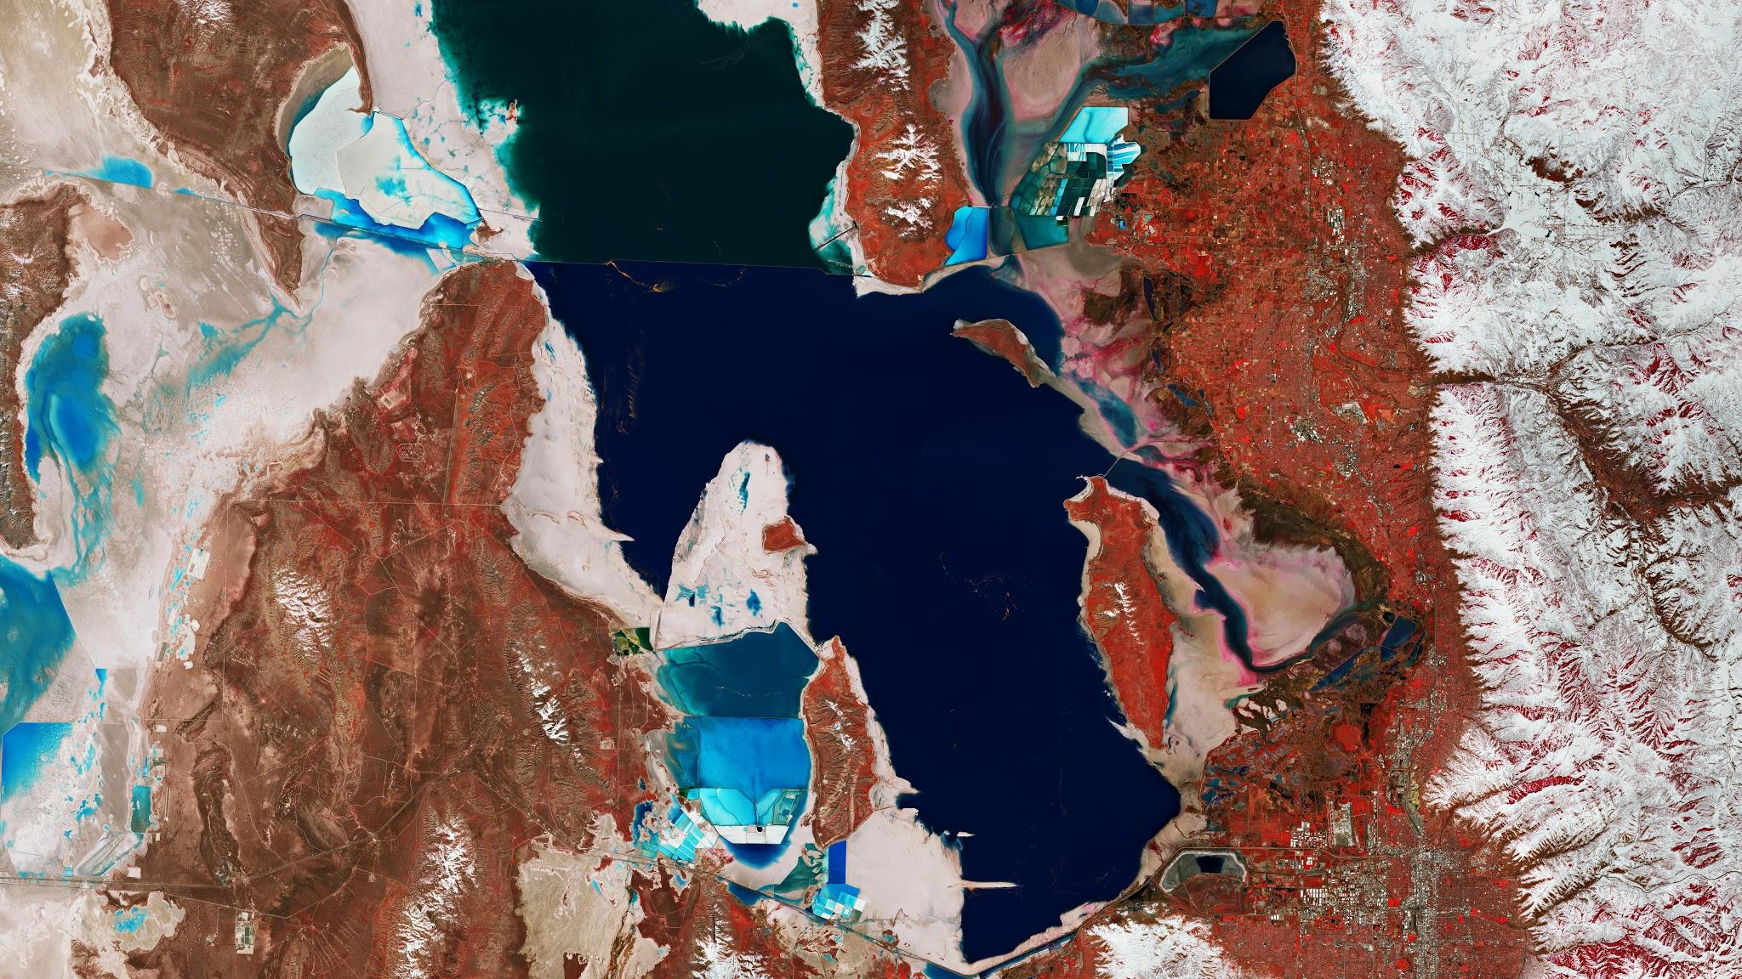
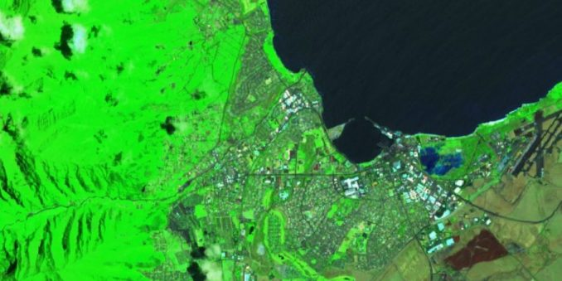
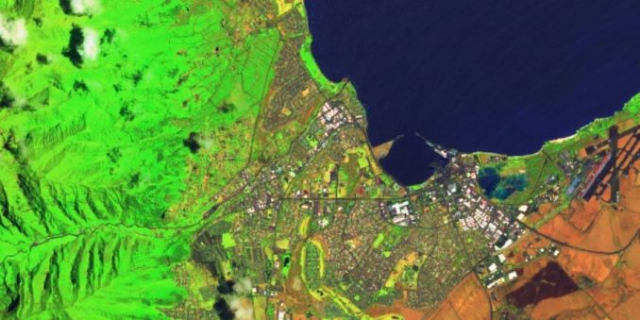
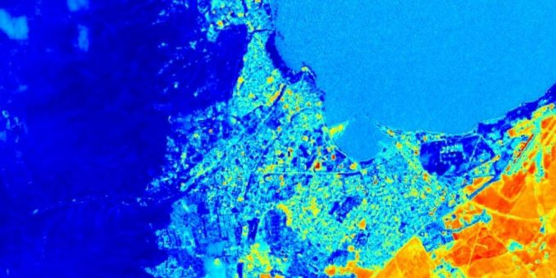
What can bands do for us?
Vegetation Density
(B12, B8A, B4)
Crop Health
(B11, B8, B2)
Moisture Index
(B8A - B11) / (B8A + B11)
Source: https://gisgeography.com/sentinel-2-bands-combinations/

Slide 13
Mahdieh Start

Slide 14
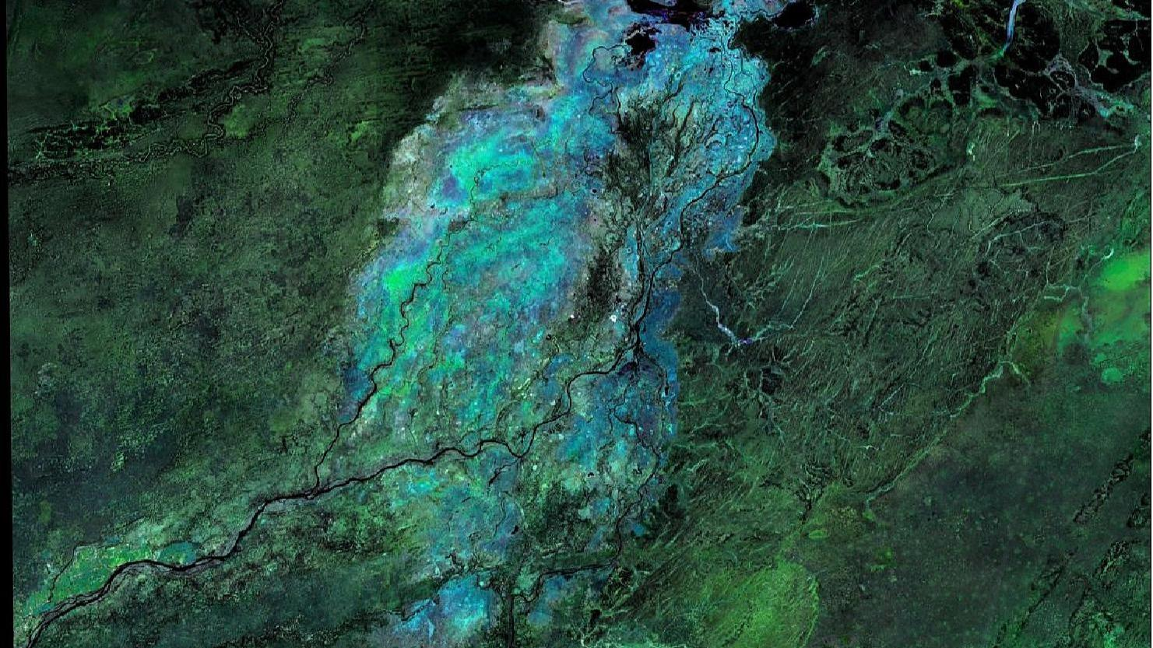
Our Ablation Process
4. Evaluate Metrics
We evaluated accuracy, precision, recall and loss to test our hypothesis
1 . Establish a Baseline
For the first round, we started with only RGB bands
For the second round, based on the metrics, we created a baseline
Ablation Study for Deep Learning
3 . Add/Remove Image Bands Systematically
Based on our hypothesis, we removed or added one or more bands and ran the model again on the same infrastructure setup with the same hyperparameters
2. Establish a Hypothesis
For the second round, we formed a hypothesis based on the evaluation metrics
Notes:
Model: ResNet50
Establish a hypothesis
Establish a baseline
Add / remove bands systematically
Evaluate with Accuracy, Precision, Recall, and Loss

Slide 15
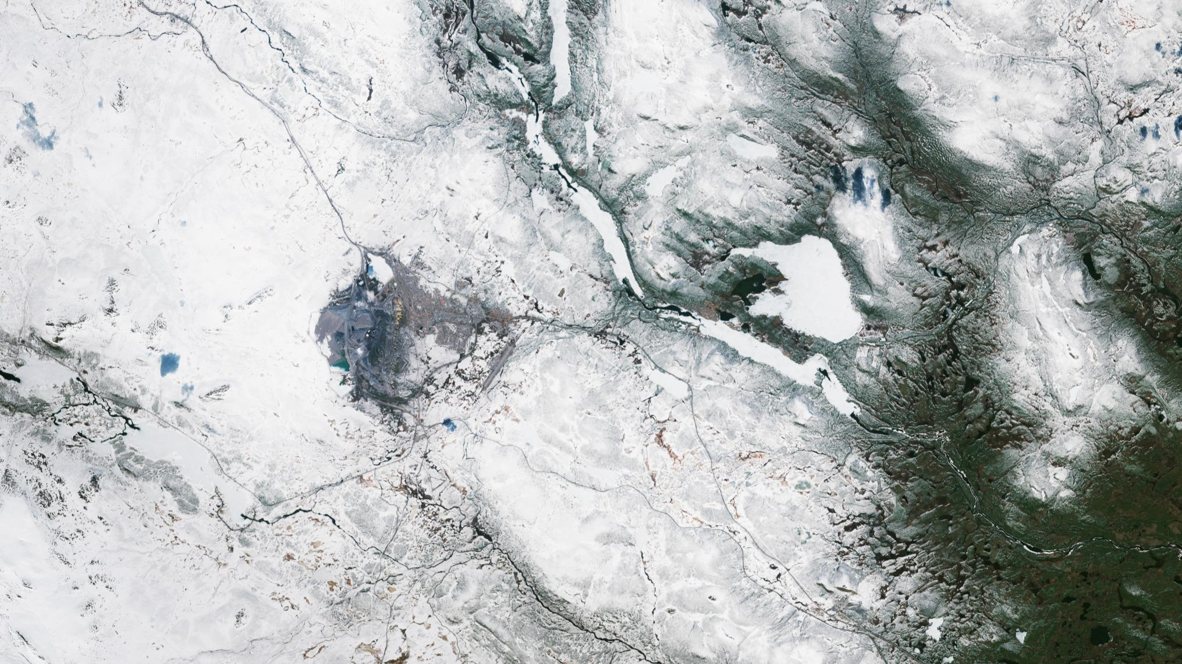
Experiment Design
We trained on all the BigEarthNet set using a custom data generator
For our experiment, we controlled for epochs and resolution
We used ResNet50 as our baseline model

Slide 16
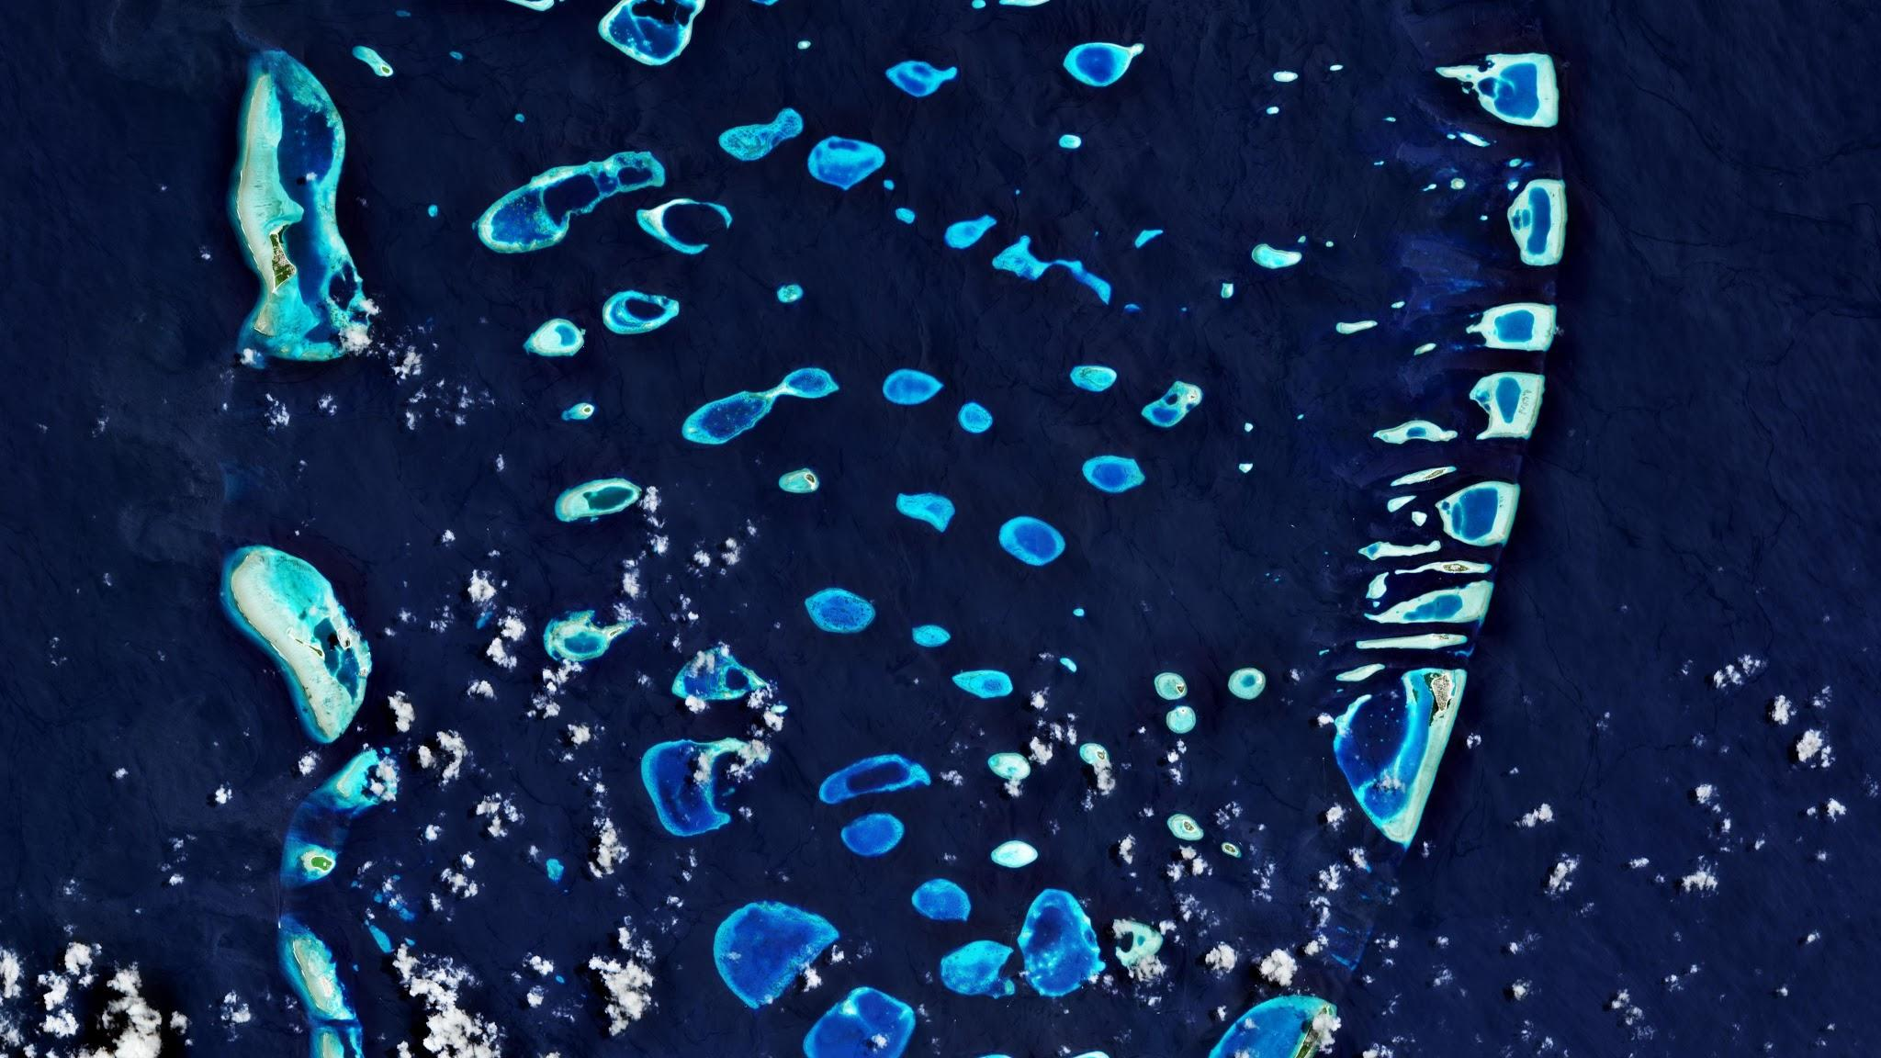
1st Round : RGB + CA + VRE yield best performance
Exp No. | Hypothesis | Result | Accuracy | Precision | Recall | Loss
1 | Baseline - RGB (B02, B03, B04) | Baseline | 0.7745 | 0.7313 | 0.8542 | 0.4758
2 | Including NIR / SWIR bands (B08, B8A, B11, B12) increased the accuracy and lowering loss | Yes | 0.8176 | 0.7721 | 0.8913 | 0.4371
3 | Including Coastal Aerosol (CA) band (B01) increased the accuracy and lowering loss | Yes | 0.8193 | 0.8004 | 0.8417 | 0.3910
4 | Including Vegetation Red Edge (VRE) bands (B05, B06, B07) increased the accuracy and lowering loss | Yes | 0.8258 | 0.7798 | 0.8993 | 0.3940
5 | Including Water Vapor band (B09) increased the accuracy and lowering loss | Yes | 0.8104 | 0.7587 | 0.8997 | 0.4342
Notes:
Experiment was focused on testing broad set of bands. Outcome is RGB + Coastal aerosol and VRE are best benchmarks.

Slide 17
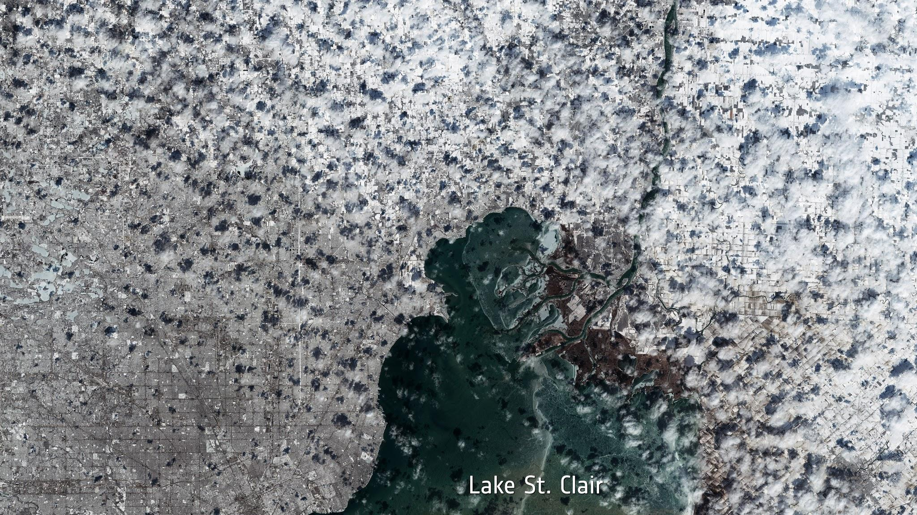
2nd Round : Do RGB matter after all? “No”
Exp No. | Hypothesis | Result | Accuracy | Precision | Recall | Loss
6 | 2nd Baseline - RGB (B02, B03, B04), Coastal Aerosol (B01), and Vegetation Red Edge (B04, B05, B06) | Baseline | 0.8260 | 0.8433 | 0.7932 | 0.3790
7 | By removing RGB (B02, B03, B04) bands and keeping only Coastal Aerosol (B01), and Vegetation Red Edge (B04, B05, B06), is the model better at classifying agricultural activity? | Yes | 0.8272 | 0.8366 | 0.8029 | 0.3751
Notes:
#6 is benchmark. We removed RGB in #7 to test performance. No degradation in accuracy and minimal loss increase.

Slide 18
Atit Start

Slide 19
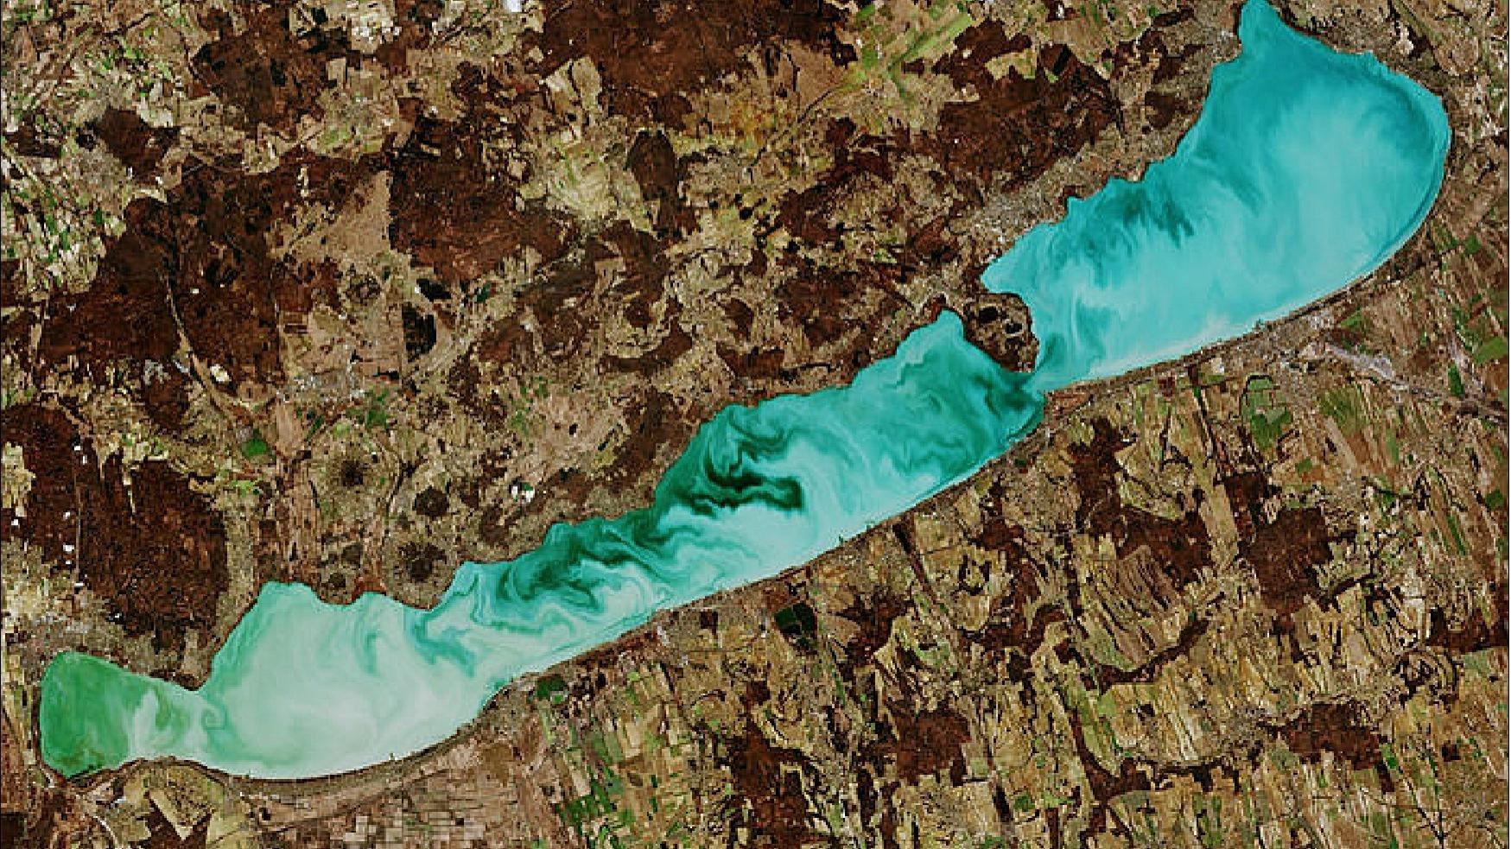
Coastal Aerosol matters only marginally
Exp No. | Hypothesis | Result | Accuracy | Precision | Recall | Loss
8 | By removing Coastal Aerosol (B01) and keeping only the Vegetation Red Edge (B04, B05, B06), can the model still classify agricultural activity well without much loss? | Yes | 0.8111 | 0.7822 | 0.8501 | 0.3998
Previous benchmark’s accuracy 0.8272
Previous benchmark’s loss 0.3751

Slide 20
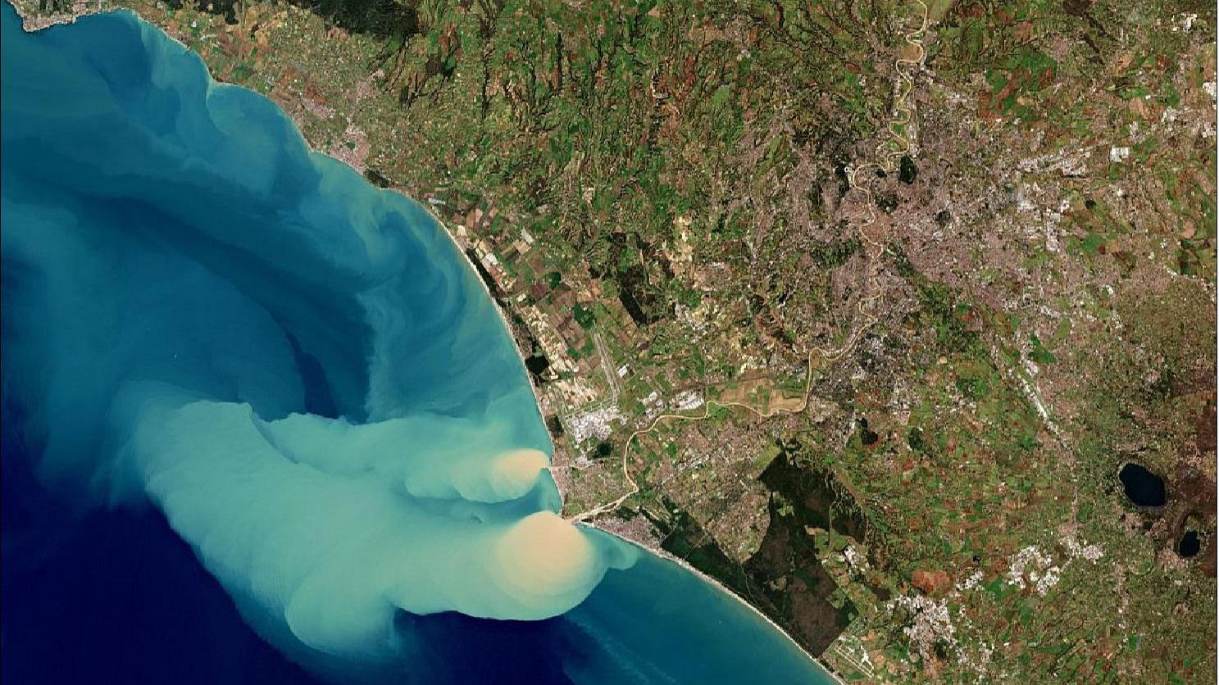
Best Prediction Ever : VRE + VNIR + SWIR
Exp No. | Hypothesis | Result | Accuracy | Precision | Recall | Loss
9 | By adding Water Vapor (B09) together with Vegetation Red Edge (B04, B05, B06), does the model result in increased accuracy and lower loss? | No | 0.7708 | 0.7633 | 0.7693 | 0.4638
10 | By adding visible and near infrared (VNIR) and short wave infrared (SWIR) (B08,B8A,B11,B12) together with Vegetation Red Edge (B04, B05, B06), does the model result in increased accuracy and lower loss? | Yes | 0.8419 | 0.8147 | 0.8755 | 0.3481
Previous benchmark’s accuracy 0.8111
Previous benchmark’s loss 0.3998

Slide 21
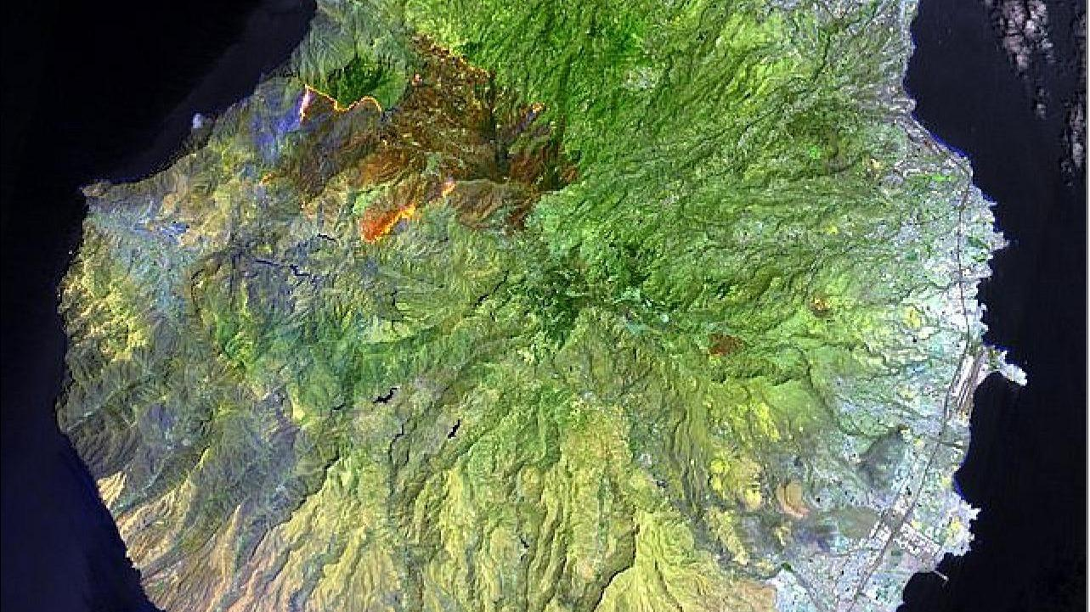
Conclusion : VRE + SWIR matter most
Exp No. | Hypothesis | Result | Accuracy | Precision | Recall | Loss
11 | Based on experiment No. 10, should short-wave infrared (SWIR) (B11, B12) be further removed from the model? | No | 0.8068 | 0.7670 | 0.8683 | 0.4413
12 | Based on experiment No. 10, should NIR (B08) and narrow NIR (B8A) be further removed from the model? | Perhaps | 0.8379 | 0.8041 | 0.8834 | 0.3648
13 | By adding B01 (coastal aerosol) back on top of B05-B07 and B08,B8A,B11,B12, would accuracy improve? | No | 0.8258 | 0.8226 | 0.8202 | 0.3750
Previous benchmark’s accuracy 0.8419
Previous benchmark’s loss 0.3481

Slide 22
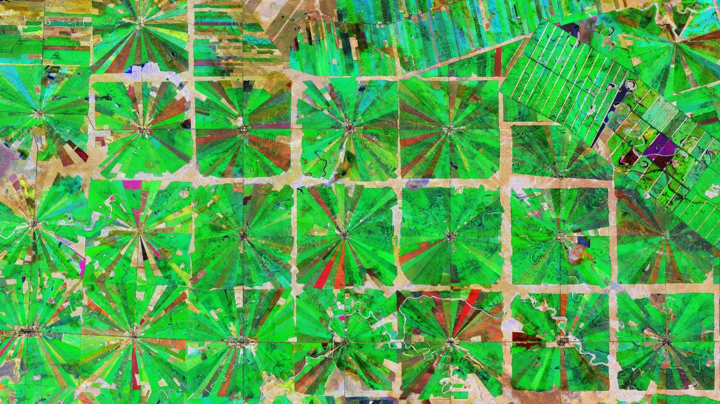
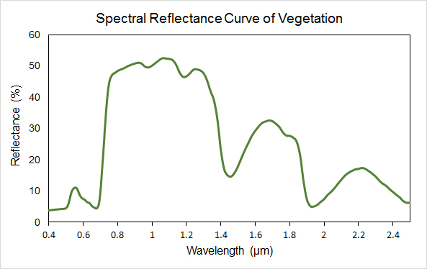
Possible Explanation
High-reflectance bands are associated with higher predictability of agricultural activity.
VREs
NIR
SWIRs
Credit: http://gsp.humboldt.edu/OLM/Courses/GSP_216_Online/lesson2-1/reflectance.html
Notes:
Reference: http://gsp.humboldt.edu/OLM/Courses/GSP_216_Online/lesson2-1/reflectance.html
“In general, healthy vegetation is a very good absorber of electromagnetic energy in the visible region. Chlorophyll strongly absorbs light at wavelengths around 0.45 (blue) and 0.67 µm (red) and reflects strongly in green light, therefore our eyes perceive healthy vegetation as green.
Healthy plants have a high reflectance in the near-infrared between 0.7 and 1.3 µm. This is primarily due to healthy internal structure of plant leaves. As this internal structure varies amongst different plant species, the near infrared wavelengths can be used to discriminate between different plant species.”

Slide 23
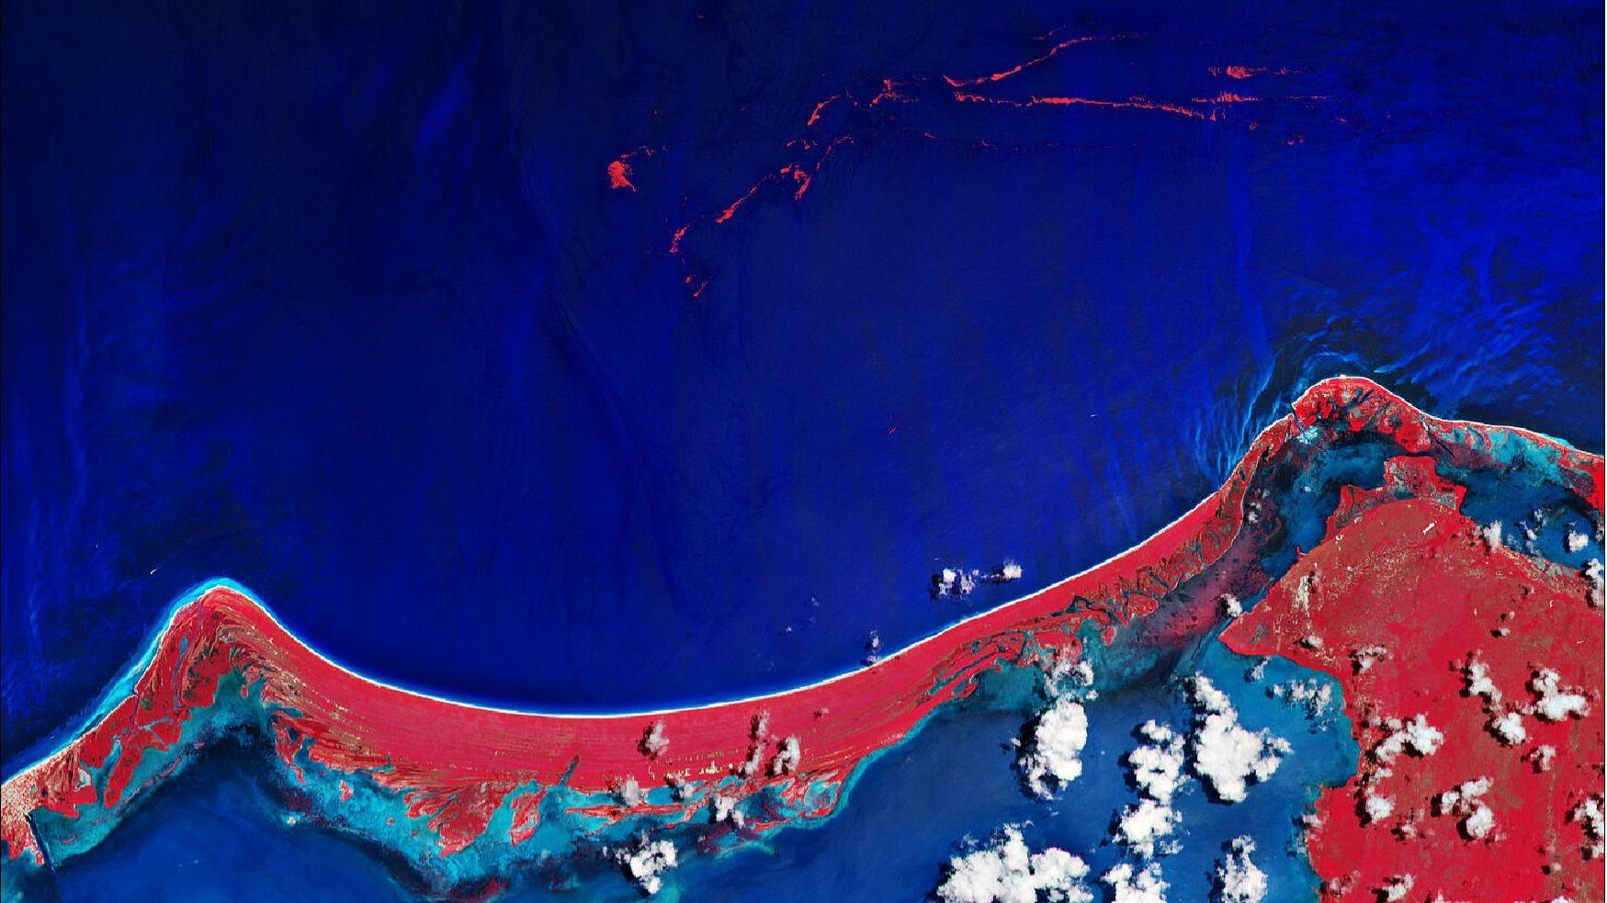
Potential Follow Up Research
Is only Green band enough?
Model choices
Would other choices (e.g., EfficientNet, etc.) result in different conclusion?
Parameter tuning
Number of epochs, pixels, batch size

Slide 24
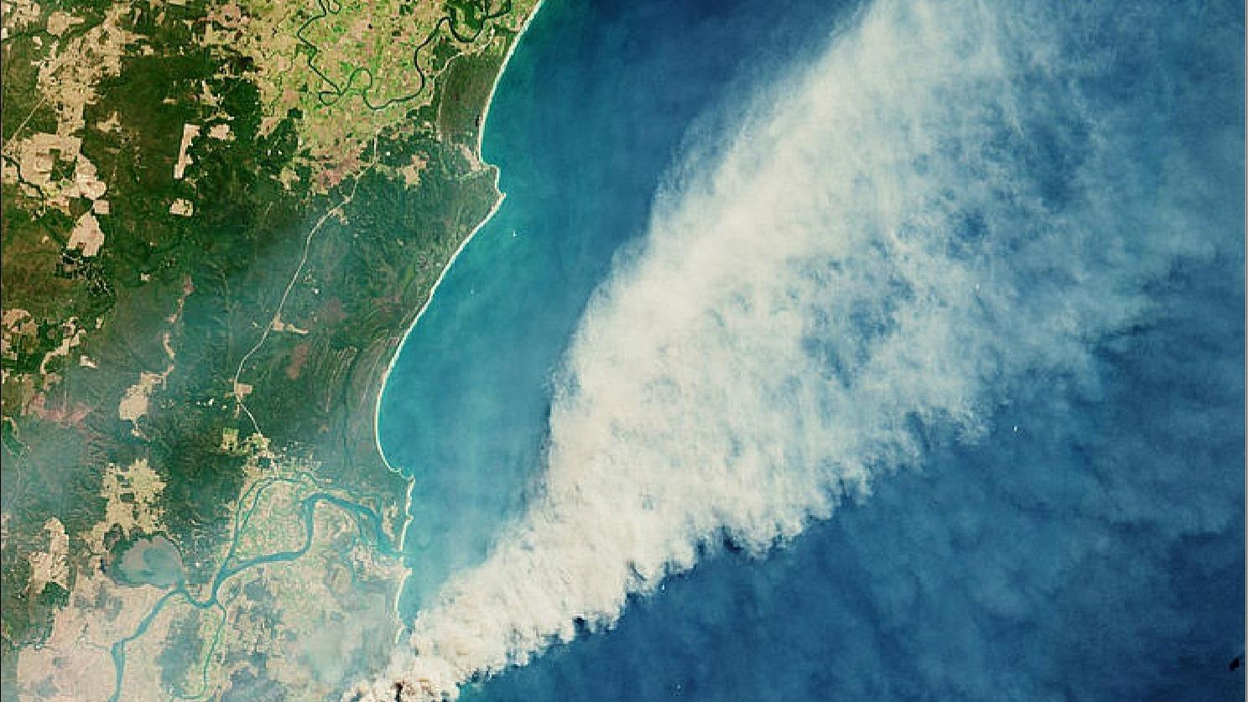
Citations
G. Sumbul, M. Charfuelan, B. Demir, V. Markl, “BigEarthNet: A Large-Scale Benchmark Archive for Remote Sensing Image Understanding”, IEEE International Geoscience and Remote Sensing Symposium, pp. 5901-5904, Yokohama, Japan, 2019.
S. Sheikholeslami, “Ablation Study for Machine Learning”, https://www.diva-portal.org/smash/get/diva2:1349978/FULLTEXT01.pdf, 2019

Slide 25
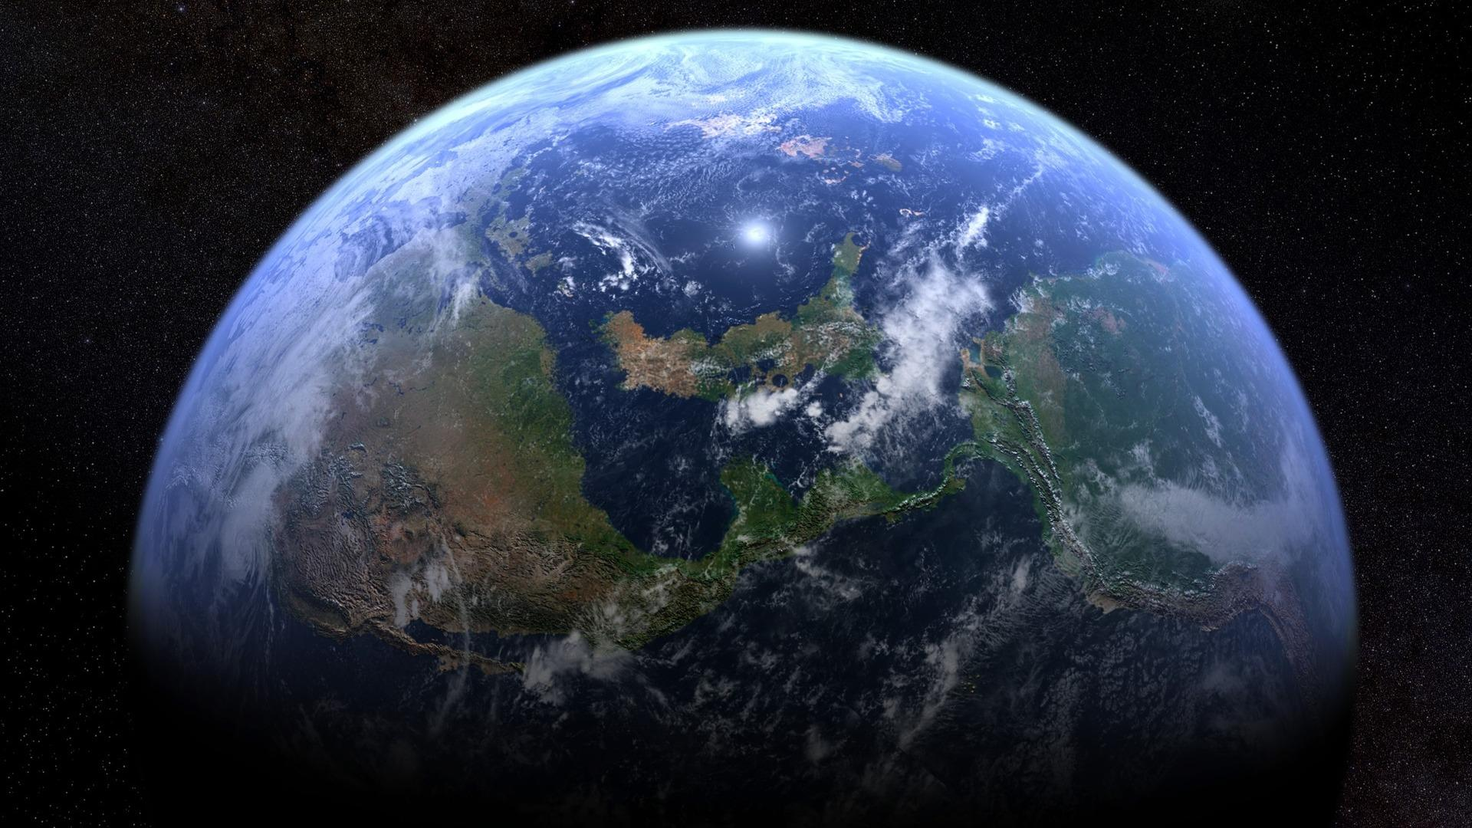
Thank You!
Check us out on GitHub!
github.com/UCB-Sentinel-2-Image-Study/ablation-study

Slide 26
Contributions
Atit
Selected model, built custom data generator, led experimentation
Jacob
Helped with pipeline, EDA, Built website
Mahdieh
EDA, Researched ablation experiments, Experimented with Maggy and DataBricks
Mumin
Computing infrastructure, ran experiments, designed slides, made burgers
Everyone
Debugging, pipeline work, documentation, research, worked on slides, contributed to repo

